Slide 1
HelixMart Vendor Sales Analysis Project Summary Report
A Comprehensive Data Analytics project based on a dataset involving information related to various vendors for a specific E-Commerce platform.
The dataset files are loaded into the SQLite database and in-depth analysis is performed by running python scripts created for specific data purposes.
An Exploratory Data Analysis (EDA) notebook is specifically created to execute and collect key insights after in-depth analysis on the modified raw data after ingestion.
Technologies Used – SQL, Python, Numpy, Pandas, Matplot, Seaborn, Jupyter, Excel and Power BI (for creating stakeholder dashboard)
GitHub Repo Link – https://github.com/Master-Helix/HelixMart-Vendor-Analysis
Created & Analysed by – RAKSHIT PANDEY
Date – 9/7/25

Slide 2
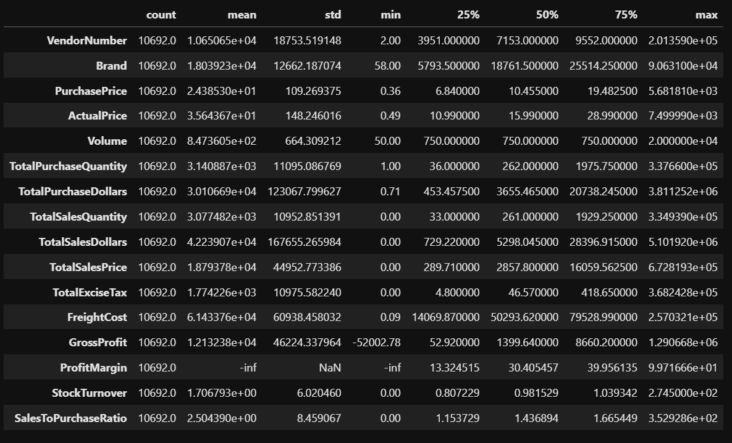
Exploratory Data Analysis Insights
Summary Statistics

Slide 3
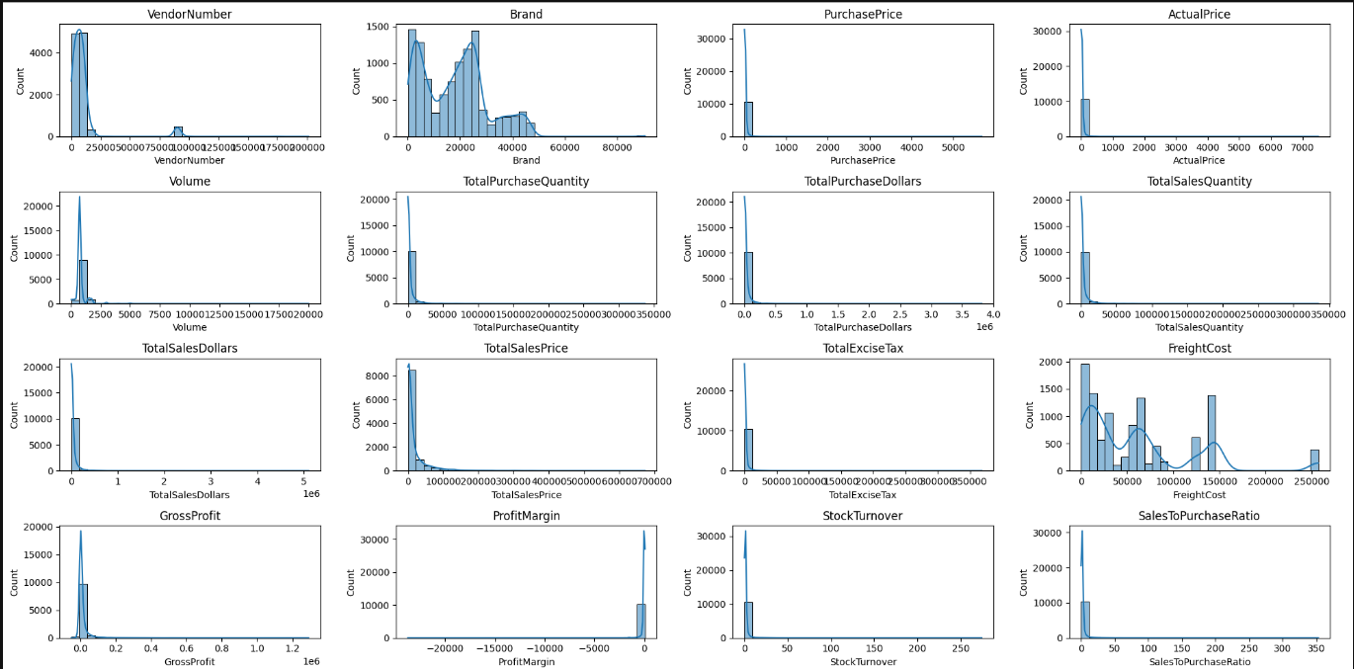
Exploratory Data Analysis Insights

Slide 4
Exploratory Data Analysis Insights
Summary Statistics Insights:
Negative & Zero Values:
Gross Profit: Minimum value is -52,002.78, indicating losses. Some products or transactions may be selling at a loss due to high costs or selling at discounts lower than the purchase price.
Profit Margin: Has a minimum of -∞, which suggests cases where revenue is zero or even lower than costs.
Total Sales Quantity & Sales Dollars: Minimum values are 0, meaning some products were purchased but never sold. These could be slow-moving or obsolete stock.
Outliers Indicated by High Standard Deviations:
Purchase & Actual Prices: The max values (5,681.81 & 7,499.99) are significantly higher than the mean (24.39 & 35.64), indicating potential premium products.
Freight Cost: Huge variation, from 0.09 to 257,032.07, suggests logistics inefficiencies or bulk shipments.
Stock Turnover: Ranges from 0 to 274.5, implying some products sell extremely fast while others remain in stock indefinitely. Value more than 1 indicates that sold quantity for that product is higher than purchased quantity due to either sales are being fulfilled from older stock.

Slide 5
Exploratory Data Analysis Insights
Data Filtering:
To enhance the reliability of the insights, we removed inconsistent data points where:
Gross Profit ≤ 0 (to exclude transactions leading to losses).
Profit Margin ≤ 0 (to ensure analysis focuses on profitable transactions).
Total Sales Quantity = 0 (to eliminate inventory that was never sold).
Correlation Insights:
Purchase Price vs. Total Sales Dollars & Gross Profit: Weak correlation (-0.012 and -0.016), indicating that price variations do not significantly impact sales revenue or profit.
Total Purchase Quantity vs. Total Sales Quantity: Strong correlation (0.999), confirming efficient inventory turnover.
Profit Margin vs. Total Sales Price: Negative correlation (-0.179), suggesting increasing sales prices may lead to reduced margins, possibly due to competitive pricing pressures.
Stock Turnover vs. Gross Profit & Profit Margin: Weak negative correlation (-0.038 & -0.055), indicating that faster stock turnover does not necessarily equate to higher profitability.

Slide 6
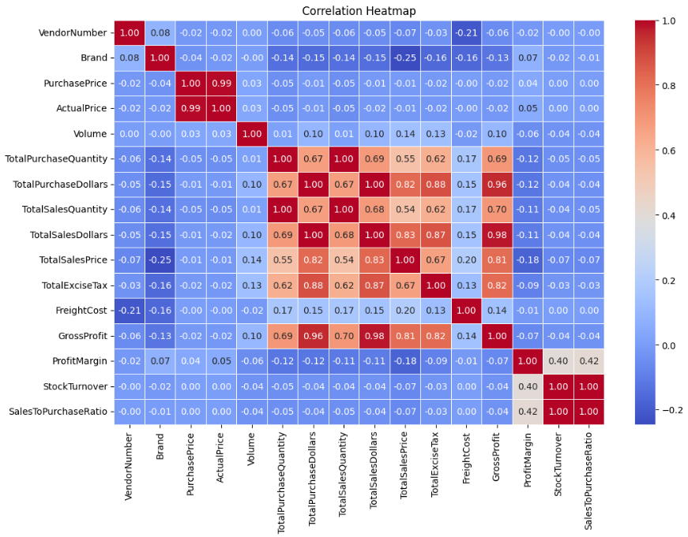
Exploratory Data Analysis Insights

Slide 7
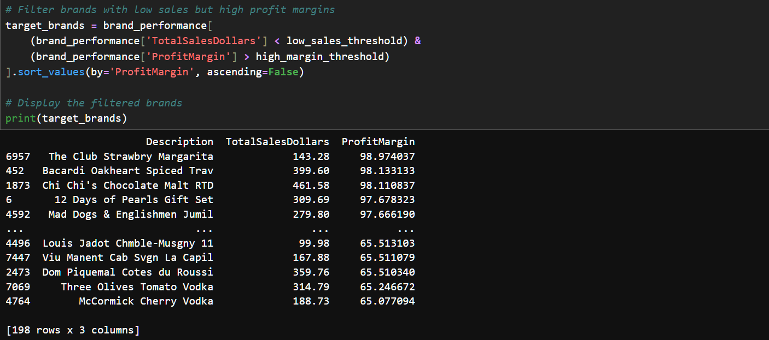
Key Research Questions
1. Brands for Promotional or Pricing Adjustments

Slide 8
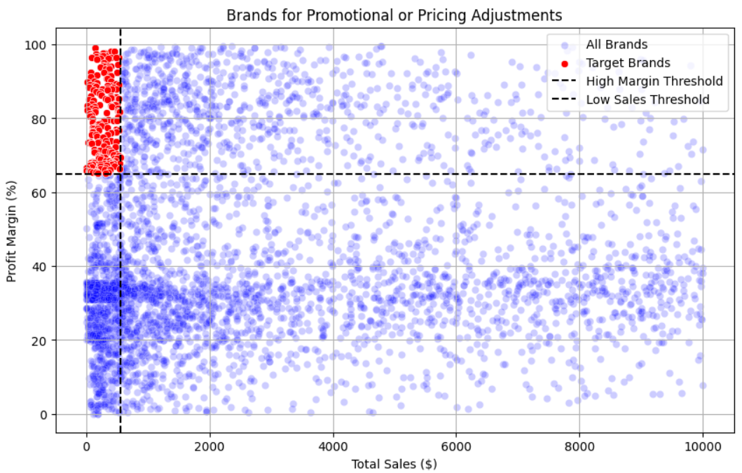
Key Research Questions
198 Brands exhibit lower sales but higher profit margins, which could be benefitted from
targeted marketing, promotions or price optimisations to increase volume without
compromising profitability.

Slide 9
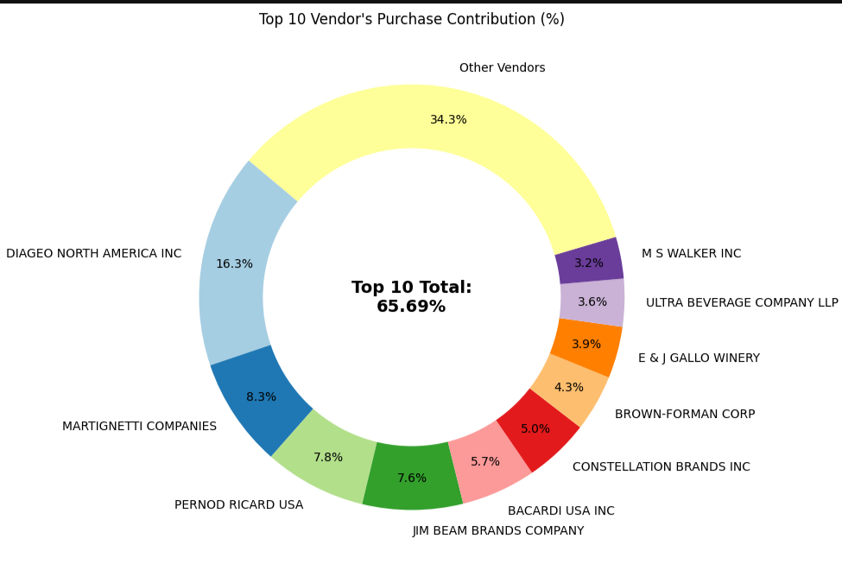
Key Research Questions
2. Top Vendors by Sales and Purchase Contribution
The top 10 vendors contribute 65.69% of total purchases, while the remaining vendors
contribute only 34.31%. This over-reliance on a few vendors may introduce risks such as
supply chain disruptions, indicating a need for diversification.

Slide 10
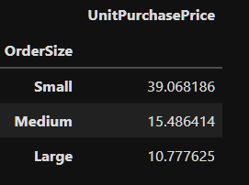
Key Research Questions
3. Impact of Bulk Purchasing on Cost Savings
Vendors buying in large quantities receive 72% lower unit cost ($10.78 per unit vs
higher unit cost in smaller orders.
Bulk pricing strategies encourage larger orders, increasing total sales while maintaining profit.

Slide 11
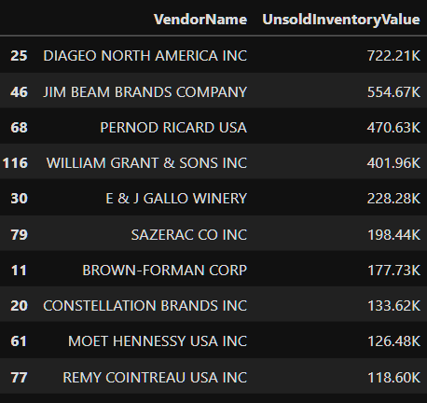
Key Research Questions
4. Identifying Top 10 Vendors with Low Inventory Turnover
Total Unsold Inventory Capital: $2.71M
Slow-moving inventory increases storage costs, reduces cash flow efficiency, and affects overall
profitability.
Identifying vendors with low inventory turnover enables better stock management, minimizing
financial strain.

Slide 12
Key Research Insights
Final Recommendations:
Re-evaluate pricing for low sales, high-margin brands to boost sales volume without sacrificing profitability.
Leverage bulk purchasing advantages to maintain competitive pricing while optimizing inventory management.
Optimize slow-moving inventory by adjusting purchase quantities, launching clearance sales, or revising storage strategies.
Enhance marketing and distribution strategies for low-performing vendors to drive higher sales volumes without compromising profit margins.
By implementing these recommendations, the company can achieve sustainable profitability, mitigate risks, and enhance overall operational efficiency.

